Slide 1
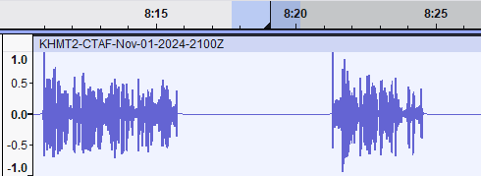



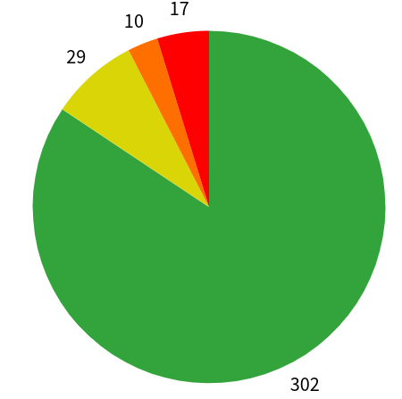
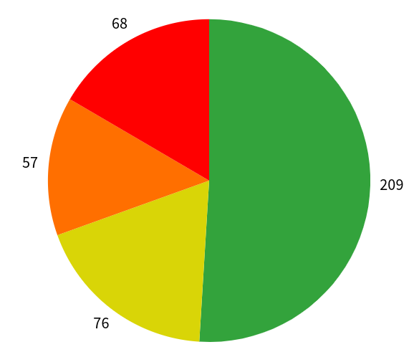
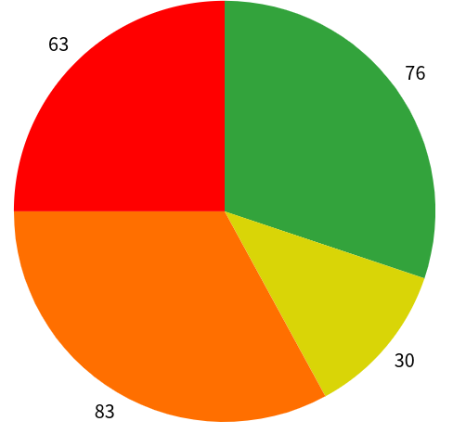
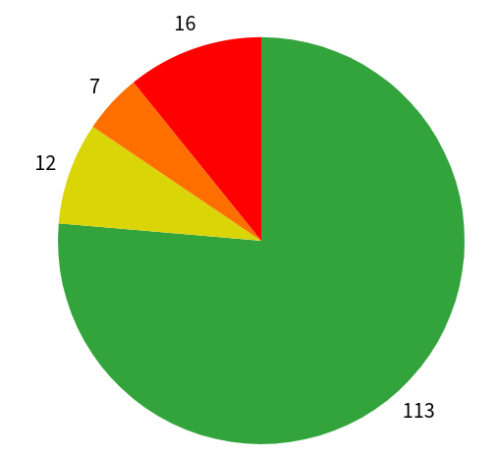

25-346
AI Speech to Text for Military Communications
Team members: Nathan Devore, Nate Eldering, Connor Kohout, Allen Lee | Faculty adviser: Tamer Nadeem, Ph.D. | Sponsor: DoD | Mentor: Clinton Farrell
Problem Statement
Current Design Flow
Audio Collection
Data Processing
Open AI Whisper Model
Text File Output
Military operations occur in noisy environments and involve specific terminology that current speech-to-text models cannot handle effectively. Our project addresses this challenge by fine-tuning OpenAI’s Whisper model, a robust speech-to-text system, for non-civilian environments.
Initial testing with real air traffic communications shows the Whisper model performs inconsistently. Our fine-tuning aims to overcome these issues, improving transcription accuracy in noisy, mission-critical settings.
Currently, real ATC audio is collected from LiveATC.net archives
LiveATC has archived audio from air traffic communications
Silence can confuse the whisper model and cause it to hallucinate, so all silence is removes using FFmpeg
Whisper is an open-source audio captioning tool developed by open-AI
We have found the medium model transcribes the audio the best
The current Whisper model is inconsistent and not very accurate
Audio is captioned and output as a .txt file
The file can then be examined for inaccuracies
These inaccuracies can help identify what the model struggles with so specific issues can be targeted
What is Whisper?
Whisper is an open-source, general-purpose speech recognition model developed by OpenAI. Trained on a diverse dataset of multilingual and multi-accented audio, Whisper offers robust performance across various scenarios, excelling at tasks like transcription, translation, and language identification.
Designed as a multitasking system, Whisper supports multilingual speech recognition, seamless speech translation, and can accurately detect the spoken language in an audio input. It comes in six model sizes, four of which are English-only, each offering a tradeoff between speed and accuracy. Whisper's versatility and robust performance make it a powerful tool for a range of speech and language applications.
Test Results
KCHO: 84.4%
KHMT: 59.2%
KTOC: 30..2%
K0V4: 76.4%
The audio was collected from the following airports:
KCHO (Charlottesville Albemarle Airport, Virginia),
KHMT (Hemet-Ryan Airport, California),
K0V4 (Brookneal-Campbell County Airport, Virginia),
KTOC (Toccoa Airport, Georgia).
Correct
Substitution
Insertion
Deletion
To establish a baseline for transcription accuracy, we manually transcribed ATC audio and compared the results to outputs from the Whisper model. The dataset comprises four audio files of varying clarity, sourced from LiveATC.net archives. This provides a robust foundation for evaluating the Whisper model.
Fine-Tuning
Fine-Tune Targets
Ideal Design Flow
Captioned Output
Whisper's baseline performance can be enhanced through targeted fine-tuning using aviation-specific data. By having pilots read scripted communications during flights and collecting the audio through LiveATC archives, we ensure the training data matches real-world radio conditions.
In its current state, Whisper struggles with identifying proper nouns, significantly hurting its accuracy. It was unable to recognize "Hemet" (the name of an airport), incorrectly labeling every instance as "have it." When we fine-tune the model, we will target proper noun recognition; this includes airport names, company names, aircraft manufacturers, and types.
Input Audio
Fine Tuned Whisper Model
Audio will be collected live from inside the cockpit or ground communications
The robust Fine-Tuned Model will process the audio in real time
Trained on aviation-specific data
Enhanced comprehension abilities, with better understanding of aviation terminology
Live transcription generates captions that are efficiently archived in text files for future reference
Automated extraction of routine information reduces cognitive load on pilots, allowing them to focus on critical tasks
Minimizes human error in aircraft communication

